Slide 1
Contract to Close
Continuing Education Class
contracttoclose

Slide 2
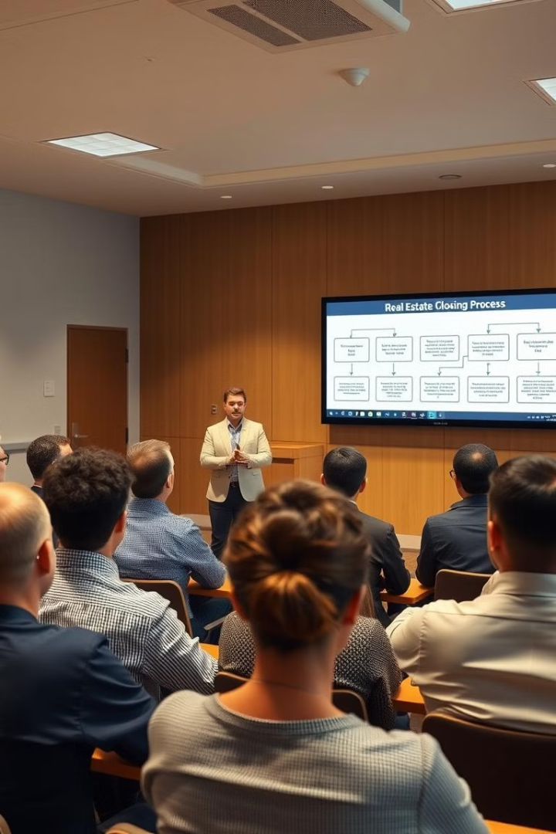
Overview
Behind the Scenes Look
  Take a behind the scenes look at the closing process
Team Member Roles
  Explore the role of each Campbell & Brannon team member
Process and Procedures
  Give insight into our process, procedures, and everything we need for a seamless closing experience.

Slide 3
Contacting C&B Team Members
First initial and last name
i.e. John Smith → jsmith@cb.law or jsmith@campbellandbrannon.com
Do not include .com after .law!
www.cb.law
www.campbellandbrannon.com

Slide 4

Who Makes Up the C&B Team?
File Intake
Title Examiner
Title Curative
Pre-Closer
Closer
Attorney
Funder/Disburser
Recorder/Post Closer
And many many more!

Slide 5

Before Writing Your Contract
Why contact C&B?
Contacting C&B before writing your contract can help ensure accuracy and completeness in your documentation which can help avoid issues later
Reach Out to C&B!
Request a legal description – attorneys@cb.law
Confirm ownership
Who needs to sign your documents?
Help with special stipulations
Unique situations

Slide 6


Red Flags!
The faster we know what these red flags the smoother closing will be.
Pre-
Foreclosure
Divorce
Death
Short
Sale
Property
Liens
Bankruptcy

Slide 7
Intake
Office Location:
Alpharetta: alphorders@campbellandbrannon.com
Buckhead: buckorders@campbellandbrannon.com
E. Cobb: cobborders@campbellandbrannon.com
Sandy Springs: sandyspringsorders@campbellandbrannon.com
Intown: intownorders@campbellandbrannon.com
Marietta West: cobborders@campbellandbrannon.com
Woodstock: woodorders@campbellandbrannon.com
Suwanee: suwaneeorders@campbellandbrannon.com
Braselton: braseltonorders@campbellandbrannon.com
North Georgia: northgaorders@campbellandbrannon.com
Oconee: oconeeorders@campbellandbrannon.com
Send us your contract immediately! We begin working on it right away even if due diligence hasn't ended.
Some title issues will take several weeks to clear so we need to get started ASAP.
Do not wait until after due diligence to submit the contract!
Unsure of specific office location? orders@campbellandbrannon.com

Slide 8
What should I send with my contract?
Full contract and all exhibits, including the counteroffer
Buyer’s and Seller’s email address and phone number
Lender contact info
Any extra documents specific to the transaction:
  Estate documents
  Divorce settlement agreements
  Corporate documents
  Trust agreements
  Death certificates
  Termite information
  If the buyer is ordering a survey or if you have a copy of the seller’s survey

Slide 9

Title Exam
The title examiner searches for all recorded documents related to the property for the last 50 years!
They send us a report of everything they find along with copies of the relevant documents.
The goal is to uncover all relevant matters in the chain of title so we can insure good and marketable title.

Slide 10
What does the title exam show?
Property Information
Ownership
Open loans
Boundary agreements
Driveway agreements
Encroachment agreements
Easements
Missing interests
Financial and Legal
The prior owner’s open loans and liens
Materialman liens
If the property is part of a mandatory HOA
IRS liens
GA Department of Revenue liens
Property tax liens
Pending litigation
And more!

Slide 11

Property Tax Report
Property Tax Information
Confirms the tax parcel ID
Confirms the size and dimensions of the parcel
Shows the most recently paid tax bill
Current Status
Ensures there are no outstanding tax bills
Lists exemptions currently in place
Alerts of any pending tax appeals

Slide 12
Title Exam and Tax Reports
The time it takes to complete a title exam depends on a variety of factors
  Where is the property?
  How big is it?
  Is it a platted subdivision or acreage?
  Does the county have restrictions in place limiting access to the deed records?
If you know there are special circumstances or have a closing date that is in less than 15 business days, please alert us so we can order the title exam as a rush file.

Slide 13

Pre-Closing: Introductory Email to Buyer

Slide 14
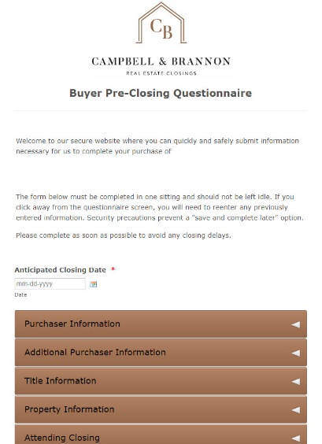
Pre-Closing: Buyer Questionnaire
Requests the information we need to draft our closing documents and send the buyer our wire instructions:
Name and contact information
Street address
Mailing address, if different than the property address
Anticipated closing date
If all buyers will attend closing
We encourage all buyers to attend closing personally!
How the buyers will hold title
Copy of their photo ID

Slide 15
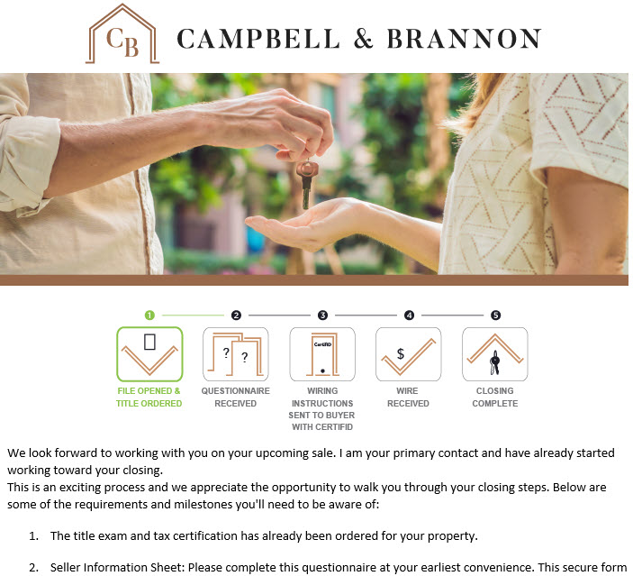
Pre-closing: Introductory Email to Seller

Slide 16
Pre-Closing: Seller Questionnaire
Our secure website allows the seller to quickly and safely submit the information necessary for us to complete the sale.
It is similar to the buyer questionnaire but also includes questions unique to the seller.
The following is needed to complete the seller questionnaire:
Copy of the mortgage statement and full loan number
HOA contact info
Water company’s information
Seller’s ID
For security purposes this must be submitted in one sitting.
The questionnaire should be submitted as soon as possible to avoid any closing delays!

Slide 17

Pre-Closing: Seller Questionnaire
Water Service
Who do you pay your water bill through?
  Paid through Homeowner's Association
  City of Atlanta Dept. of Watershed Management **Please note: City of Atlanta requires prepayment to process, this will be collected at closing**
  Cobb County
  Fulton County
  Gwinnett County
  City of Roswell, Milton or Alpharetta
  Others

Slide 18
Pre-Closing: Seller Questionnaire
SELLER PROCEEDS
Options for Receiving Proceeds:
  Check at closing: Please note that some banks may put a hold on the check
  Wire after closing
  Apply funds to purchase that is being handled by Campbell & Brannon.
Wire Authorization Form
If we do not receive the outgoing wire authorization from the seller in person they must complete the CertifID wire verification (more on CertifID in a minute).
If you choose to have your proceeds wired, please do one of the following:
  Attach your wire instructions, bring your wire information, OR attach a voided check
For brokerage accounts (i.e. Charles Schwab, Merrill Lynch or Morgan Stanley), a voided check is not sufficient for wiring. Check with your banker/financial advisor for their official wiring instructions.

Slide 19
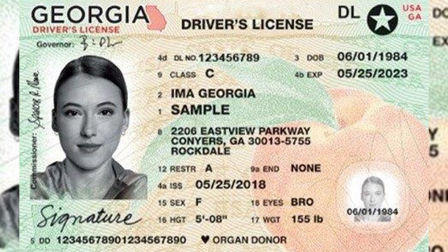
Pre-Closing: Seller Questionnaire
Asks the following:
Address of property being sold
Sellers’ names
Copy of your photo ID
Contact information
Social Security Number – this field is encrypted and required for tax purposes
Loan number
HOA information

Slide 20

Pre-Closing: Seller Questionnaire
CLOSING ATTENDANCE AND SIGNERS
Closings run more efficiently when all parties are present. Being present reduces closing and funding issues.
Will all sellers on title attend closing?
If any seller is not able to attend closing, their options include:
Split closing: Seller signs in our office before the buyer. There is a fee for this service.
Email/Mail away: Seller signs documents sent via secure email. At minimum a printer, a witness, and a notary public are required. There is a fee for this service.
If the seller is abroad, please let us know ASAP as they may be required to set up a notary appointment with the US Embassy

Slide 21

Pre-Closing: Seller Questionnaire
Power of Attorney (POA)
If you choose a Power of Attorney, you must complete the CertifID wire and identify verification process.
Recommendations
If possible, we recommend you use a POA specific to this real estate transaction and drafted by our office.
If providing your own POA, we must approve the document well in advance. Please note that many durable and general POAs are not consistent with Georgia real estate law.

Slide 22
Pre-Closing: Seller Questionnaire
TAX APPEALS
If a tax appeal is filed, the tax commissioner issues a bill for unresolved tax appeals at 85% of the maximum amount due based on the assessor’s value.
If your tax appeal is still active by closing time, we will need the final bill to disburse funds escrowed at closing for the tax appeal.
Other Tax Matters
Are you filing a joint tax return?
If no, what percentage of the proceeds will each seller receive?
This is required for IRS purposes
i.e. Seller 1: 40%, Seller 2: 60%

Slide 23
Pre-Closing: Seller Questionnaire
Georgia Withholding
3% of the Net Taxable Gain
Exempt if:
  Georgia Resident (you cannot lose residency until you establish residency somewhere else)
  Selling Primary Residence (2 of the last 5 years)
  May be deemed a resident if:
    Filed GA tax returns for the past two years; AND
    Is an established business in GA and will continue to be a business establish in GA or has real property in Georgia at the time of closing of equal or greater value than the tax liability; AND
    Will report sale on their GA tax return; AND
    If seller is a corporation or limited partnership, seller is registered to do business in Georgia

Slide 24

Pre-Closing: Seller Questionnaire
Georgia Withholding
If you are not exempt the DOR
withholds 3% of the net taxable
Gain
Net taxable gain is determined by:
    Sale Price
    - Cost Basis
    - Selling Expenses
    Net Taxable Gain

Slide 25
Pre-Closing: Seller Questionnaire
FIRPTA
Are you a non-resident alien?
If Yes, our office will contact you about the possibility of FIRPTA withholding.
If your seller is a non-resident alien let us know ASAP so we can refer them to individuals who specialize in FIRPTA withholding to determine their tax liability
Sales Price $300,000 or less and buyer acquires as principal residence | No Withholding
Sales Price between $300,001-$1,000,000 and buyer acquires as principal residence | 10% Withholding
All transactions—Any Sales Price and buyer NOT acquiring as principal residence | 15% Withholding

Slide 26

CertifID
CertifID is an application that allows for real-time verification of devices (cell phones), individual identities, and bank account information. Think Big Brother and Big Data!
Wires are insured for up to $1 Million when using wire instructions received through CertifID.
Enables real-time verification of:
Devices
Individual Identities
Bank account information

Slide 27
Pre-Closing
Trusts:
Trust Agreement
Certificate of Trust is acceptable.
Estates:
Last Will & Testament and Letters Testamentary OR equivalent probate.
If Joint Tenants, we only need the Death Certificate.
LLC:
Operating Agreement
If Sole Member we accept Sole Member Certification
Corporate Resolution with Signing authority
INC:
Articles of Incorporation from Secretary of State website
By-Laws
Special Sellers

Slide 28
Pre-Closing: Initial Contract Review
Who signed the contract?
Type of client | Who signs? | Signature Examples | Docs to send with the contract
Estate owner | Executor or Administrator signs as “Executor or Administrator of the Estate of homeowner” | Sally Seller, as Executor of the Estate of Simon Seller, deceased OR Sally Seller, as Administrator of the Estate of Simon Seller, deceased | Letters Testamentary and Will OR Letters of Administration (must probate estate to sell)
Trust | Trustee of the trust | Sally Seller, as Trustee of the Sally Seller Trust dated 7/7/2021 | Trust Agreement or Certificate of Trust (a/k/a memo of trust)
Corporation | President or Vice President of corporation (a/k/a CEO or CFO) | Simon Seller, as President of ABC, Inc. | Corporation’s Articles of Incorporation
Limited Liability Company (LLC) | Member or Manager of LLC | Sally Seller, as Member of ABC, LLC OR Sally Seller, as Manager of ABC, LLC | LLC Operating Agreement
Power of attorney (POA) | POA signs as “attorney in fact for client” | Sally Seller, as Attorney-in-fact for Simon Seller | Original POA

Slide 29
Pre-Closing: Initial Contract Review
Look for all terms relevant to the closing
Insure we received all exhibits
Termite? Home warranty? Survey? Other items a party is paying for at closing?
Stipulations that will impact closing or the settlement statement

Slide 30
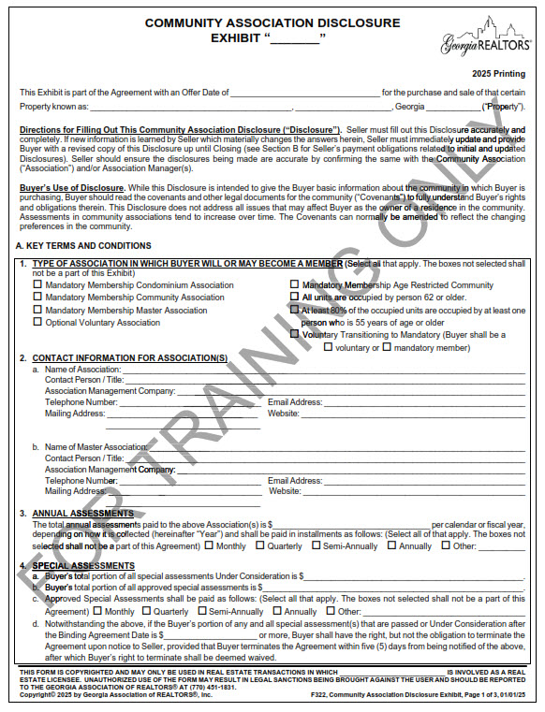
Pre-Closing: CAD
Information on the CAD allows us to order the HOA closing letter.

Slide 31
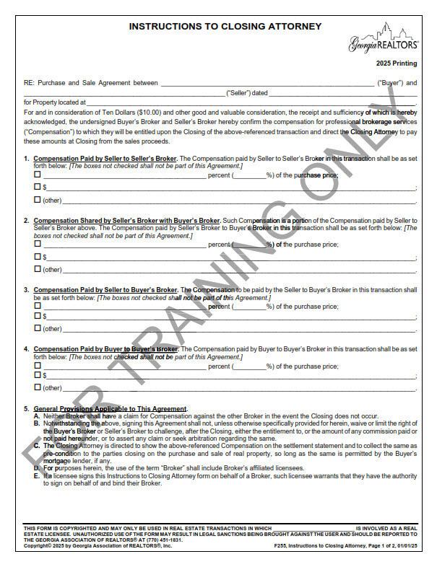
Pre-Closing: Compensation
Instructions to Closing Attorney (F255)
Total amount of Compensation paid?
Who/how will the Compensation be paid?
Any contributions to closing costs or paying for items on behalf of the client
Depending on how the Compensation is handled you may need the Buyer and/or Seller’s signature on F255.
Practice Tip! We recommend having F255 signed immediately after going binding.

Slide 32
Pre-Closing: The Lender
Send title commitment to lender
Confirms property taxes, HOA fees, transfer/intangible tax, recording fees, etc.
Coordinate with lender’s underwriter for any title related questions

Slide 33
Title Insurance
PROTECTS YOUR LARGEST INVESTMENT!
The Owner’s Title Policy protects against defects that are missed or cannot be discovered in a routine title exam and title problems that are created after the title exam but before closing.
The seller only guarantees that they have not created a title issue. The purchaser has no recourse against the seller for problems created by prior owners. Title insurance provides this protection.
Owners vs. Lenders Title Policy
The one-time payment protects you and your heirs for as long as you own the property
Insures Good and Marketable Title – defends title and pays for claims from loss due to a covered risk

Slide 34

Enhanced Owner’s Title Insurance
Post-Policy Forgery
Post-Policy Encroachments by Neighbors
Post-Policy Adverse Possession
Post-Policy Easement by Prescription
Building Permit and Zoning Violations
Vehicular and Pedestrian Access
Restrictive Covenant Violations
Policy amount increases 10% per year up to 150% of original policy amount
Pays rent/expenses if you cannot live in your home due to a claim

Slide 35
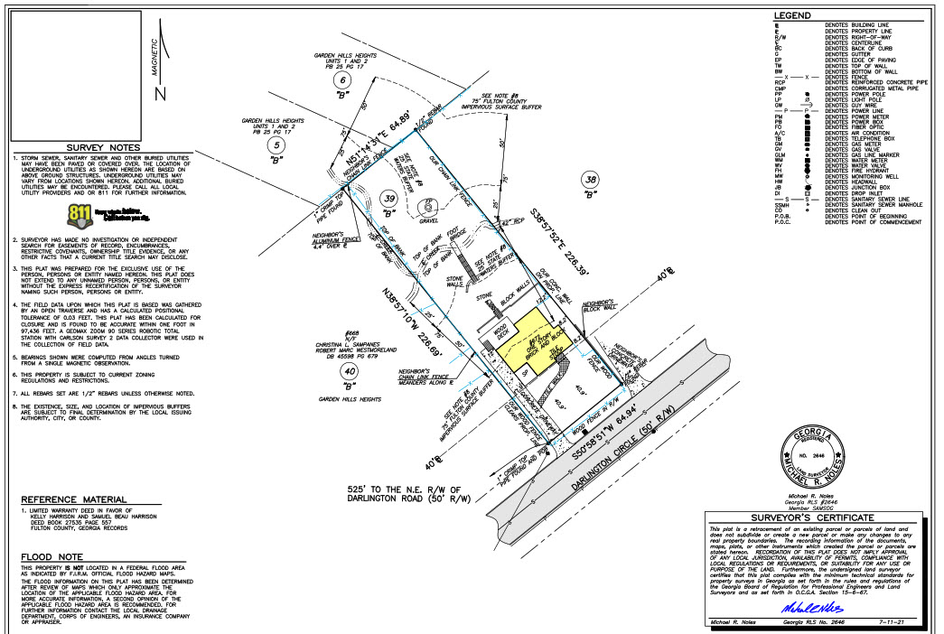
Surveys
Georgia is a buyer beware state – buyer has a duty to inspect the property
A survey will identify boundary lines, setback lines, improvements, stream buffers, easements, encroachments, etc.
If will also note if the property is in a flood zone.

Slide 36

Seller’s Survey
A surveyor’s liability runs ONLY to the name(s) on the survey. Only those named on the survey have recourse for a surveying mistake.
An old survey is for information only.
Stream buffers are newer and many older surveys do not show stream buffers.
  A stream (by the state’s definition) is difficult to determine by a buyer’s visual inspection of the property.
Newer surveys are conducted using more precise equipment.

Slide 37
Surveys in Due Diligence
If a survey comes back after the due diligence period, buyers can object to title matters but have no recourse for non-title matters such as:
Stream Buffers
Flood Zone
Easements that limit the possibility of building
Property is not as big as you thought
If you cannot get a survey during due diligence you can include a special stipulation for survey matters.
  Should Buyer obtain a recent survey of the property, Buyer shall have the right to terminate the Purchase and Sale Agreement without penalty and with full refund of all Earnest Money if in Buyer’s sole discretion any matters revealed by said survey are objectionable to Buyer. Buyer shall notify Seller of such termination for matters revealed by said survey no later than ___ days from Binding Agreement Date.

Slide 38
The Closer
Works with Lender to balance the CD and receives the final loan documents.
Balances the closing file and sends the settlement statement in advance to review.
Confirms receipt of all items referenced in the contract: termite, home warranty, HOA letter, insurance, water bills, etc.
Prepares, with the attorney, deeds, affidavits and other documents signed at closing.
Confirms receipt of wires

Slide 39

Closer: Taxes and Escrow
Estimated Taxes:
If property has more than homestead exemption or is new construction, we will ask lender if they need estimated taxes depending on the time of year.
We include estimated taxes for the following year on the title commitment.
We review the exemptions on the tax report for any significant exemptions.
New constructions amounts should be based on the % of completion as of January 1st
Tax Assessments:
If the assessment is released, we use the assessment amount for tax prorations prior to the bill being released rather than the prior year

Slide 40
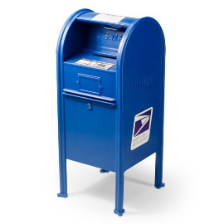
Closer: Parties Not Attending Closing
Closer – Parties not Attending Closing
Seller Mail Away:
Seller will need to be available on the closing date in case the buyer’s loan package includes documents to be signed by the seller.
Confirm with the seller that they can print the documents. Seller mail away documents are on letter size paper.
We send a prepaid FedEx label and require a copy of the signed documents to review before they drop them off.
CASH Buyer Mail Away
Documents can be signed electronically
We do not require originals

Slide 41

Closer: Parties Not Attending Closing
Closer – Parties not Attending Closing
Loan Buyer Mail Away
We strongly discourage a mailaway with a loan package. A POA is typically a much better option.
The lender must send us the loan package at least 3 days prior to closing to provide enough time to send the documents to the mobile notary.
We will set the buyers up with a mobile notary. The fee for a mobile notary varies and will be collected from the buyer on the settlement statement.
The buyer cannot sign with the mobile notary until the closing day.
A copy of the signed documents must be returned to the closer to review prior to returning the original package.
The closing is not complete and the proceeds will not be disbursed until the original documents are delivered to our office the next day

Slide 42
Wiring Funds
Wire funds at least one day prior to closing!
A buyer should contact their bank to confirm wiring procedures - many banks require you appear in person to initiate a wire.
If funds are coming from an investment account the wire may need to be initiated further in advance.
A buyer should only rely on wire instructions provided through CertifID and confirmed over the phone via an independently verified number.

Slide 43
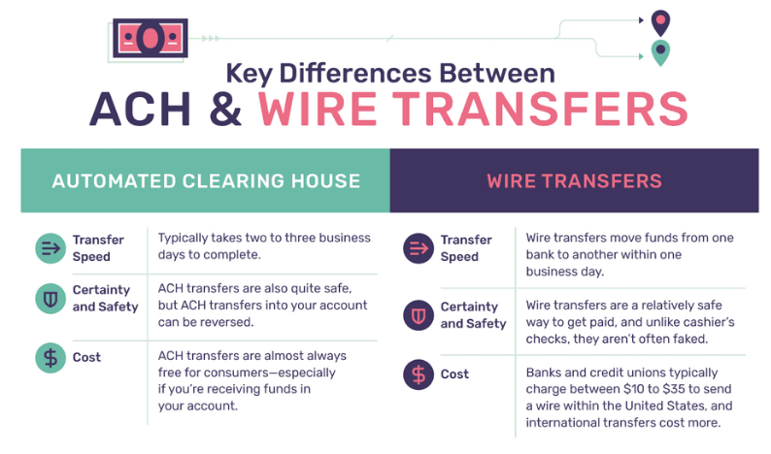
Wiring Funds
NO closing attorney can accept an ACH transfer for closing funds. Our account automatically rejects ACH wires.

Slide 44
Closing Day Checklist
Buyers:
Unexpired government issued photo ID
Second form of ID (not a credit card)
Confirmation that funds were received by Campbell and Brannon
A check or checkbook
Original Power of Attorney, if applicable
Sellers:
Unexpired government issued photo ID
Keys, garage door openers, amenity cards, garage codes
Original Power of Attorney, if applicable
Wire Instructions

Slide 45
Closing Day Checklist
Agents:
Ensure your clients are aware of office location and closing time
Communicate any special needs to Campbell and Brannon (disability, babies, pets, etc.)
Earnest Money, if needed

Slide 46

Ask
CBee…
GENERAL QUESTIONS
FOR COST ESTIMATES
What is title insurance?
Where is my closing?
When is my closing?
Do you accept checks?
Rates/Fees
Seller Net Sheet
Buyer Cost Estimate
Refinance Cost Estimate
©2023 Campbell & Brannon, All Rights Reserved.

Slide 47
24/7
Ask CBee
ABOUT A CURRENT CLOSING
DOCUMENT RETRIEVAL
Who is my pre-closer?
What are your hours?
Who orders the survey?
How can I send my earnest money?
Are we funded?
Are we recorded?
Show me my active closings
Did you receive the contract?
Show my closed transactions for 2024
Buyer closing package (BUYER ONLY)
Seller closing package (SELLER ONLY)
Signed settlement statement (ALL PARTIES)
Recorded deed (ALL PARTIES)
First payment letter (BUYER ONLY)
Tax proration agreement (BUYER ONLY)
Home warranty (BUYER AND AGENTS ONLY)
HOA letter (SELLER ONLY)
Payoff statements (SELLER ONLY)
1099 (SELLER ONLY)
©2023 Campbell & Brannon, All Rights Reserved.

Slide 48



Ask CBee
Add CBee
To Your Contacts
Practice Tip!
Make sure all contracts include your current cell phone number.

Slide 49

Questions?

Slide 50
Need help with a legal description, writing a special stipulation, etc.?
Attorneys@campbellandbrannon.com

